Slide 1
FinTech PPT
By team Afr-Asia: Chinmay B., Glennmark R.,Megh S., Mohammed Taha

Slide 2
Content
Problem
Proposed solution
Ui:client
Data Warehouse
Benford Law
Lowess Regression
Apriori Algorithm

Slide 3
Problem
With the evolution of technology, there have been increasing number of instances where many have been victims of fraudulent transactions around the globe.
With the monolithic/legacy system implemented in majority of the financial institutions (especially nationalized banks)and black hat hackers developing various techniques to infiltrate the system, fraudulent transactions have been taking not only in the front end but even from the backend .
Moreover, recently many Indian banks have faced mergers where 2 or 3 banks merged together in the name of compliance and capital adequacy. This has resulted in various heterogenous data being amalgamated into one single monolithic/unified system which may have been an issue.

Slide 4
Proposed Solution
For the integration of the data we decided to develop a prototype data warehouse in order to amalgamate the desired data in a designated area. The dwh will provide relevant information to relevant department with the help of ETL process queries which will be quite efficient in organizing the data.
In order to solve the financial transaction, we could use mining algorithm collected using the dwh that has been made. The mining algorithms which could be implemented could be regression analysis as well as we could use the classification algorithm and with the aid of Benford law and/or the Apriori algorithm to aid us in identifying the fraudulent transactions
Thus the final product would be a GUI where we can see the organized frequent itemset as well as to display the fraudulent activity we will be displaying the transaction as well as the probability of suspicion simultaneously and the transaction could be listed as per priority based

Slide 5
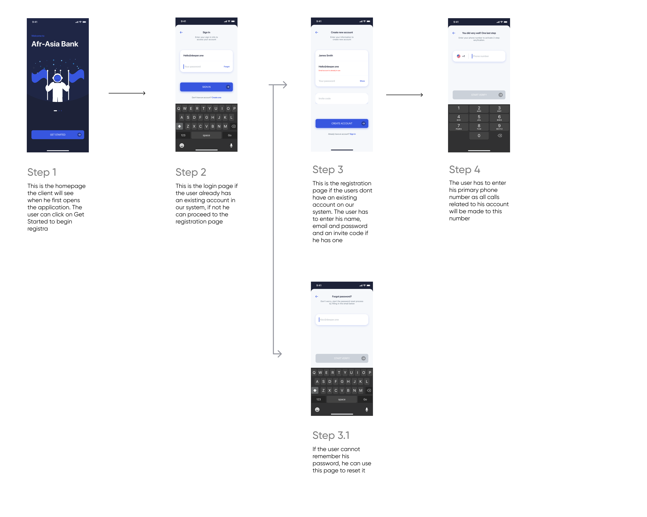

Slide 6
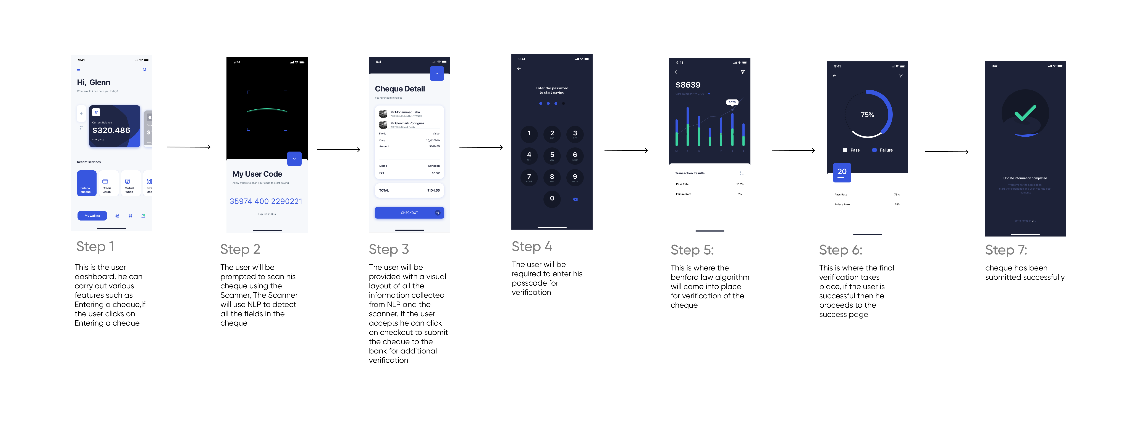

Slide 7
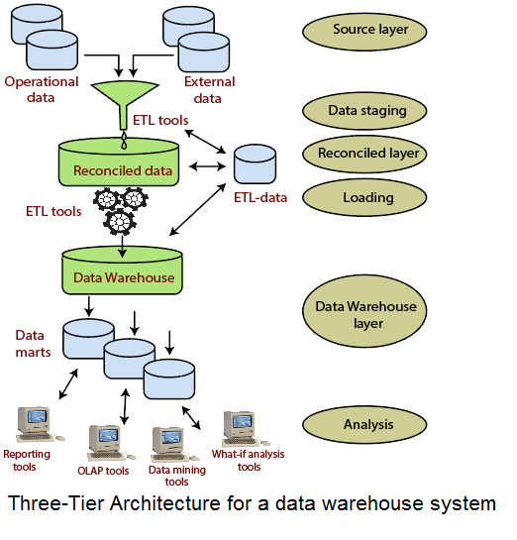
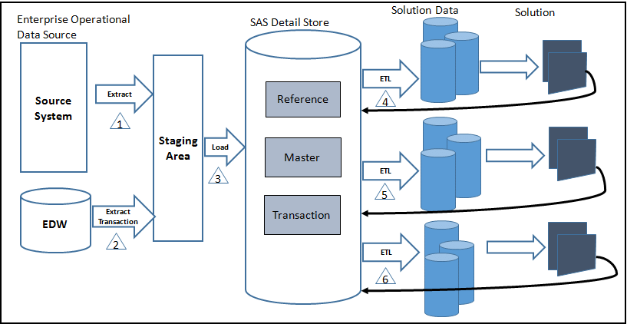
Data Warehouse

Slide 8
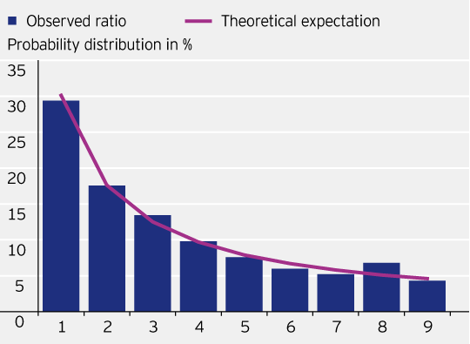
Mining techniques: Benford law

Slide 9
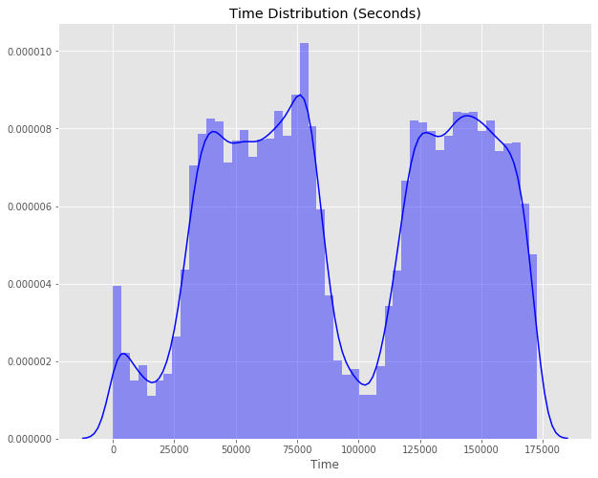
Lowess regression analysis

Slide 10
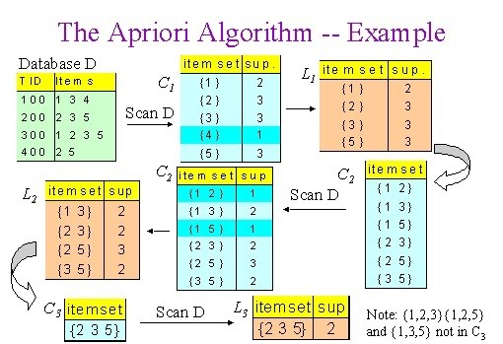
Apriori algorithm

Slide 11
The end

